Slide 1
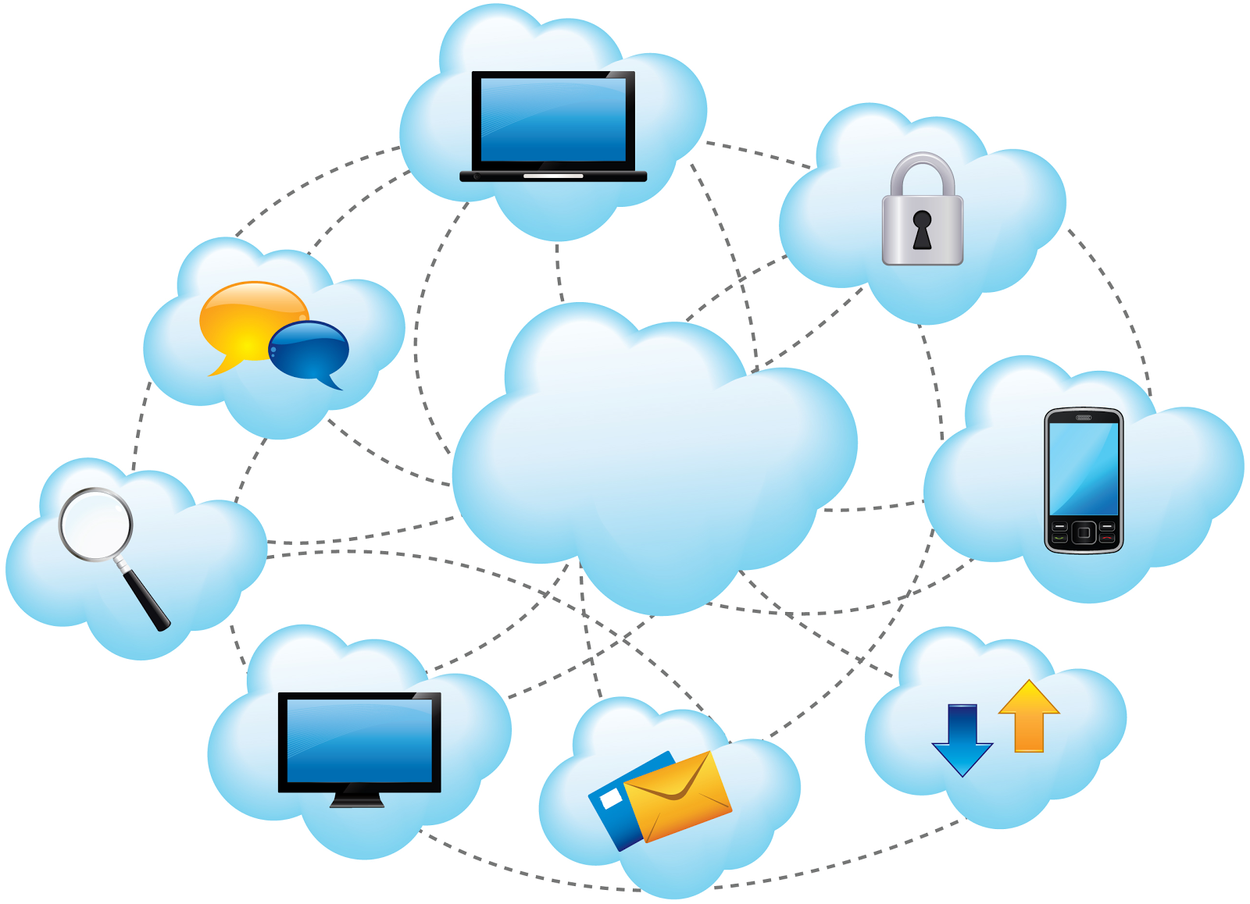
CLOUD COMPUTING
MEGHANA
BHAVANI
PAVANI
LAHARI

Slide 2
CRYPTOSYSTEM FOR SCALABLE DATA SHARING IN CLOUD COMPUTING

Slide 3
ABSTRACT
Data security is the challenging issue in cloud computing paradigm where the user store sensitive information on cloud servers. Existing solutions generally use cryptographic methods like encryption and decryption. The biggest concerns with cloud data storage is that of data integrity verification at un trusted server. To preserve the data privacy, a basic solution is to encrypt data files, and then upload encrypted data into the cloud. For this it is proposed to have a public key CRYPTOSYSTEM for the storing and accessing for data in cloud. Now this system proposes to introduce variable size CRYPTOSYSTEM that is supported with a set of secret keys as a single keys and the process uses the power of the all the keys by using these compact aggregate key we encrypt files and storing cloud. This key is positive others who shares the data. By using this key others can share data in secured way. keywords:cryptosystem,integration,encrypt,decrypt,confidentiality

Slide 4
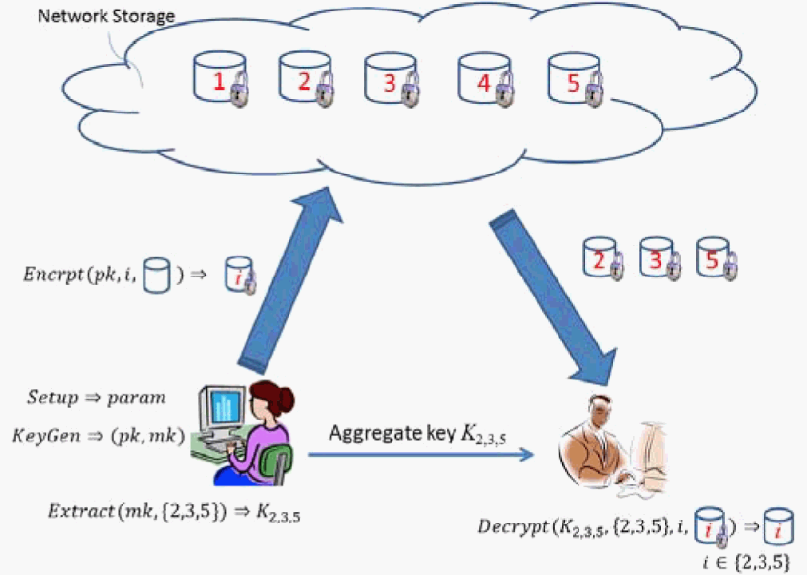

Slide 5
MOTIVATION
In entrusted storage data servers are not allowed to learn the content of sensitive data and also they are not relayed on to enforce data access policies to keep data confidential to data servers the data owner encrypt the data before upload user access is granted by possessing the data decryption keys.
A promising solution to multicast encryption is predicate based encryption(PBE).It is a novel encryption technique in which decryption of cipher text depends on set of attributes that satisfies a predicate.
The generalization of attribute based encryption (ABE)and identity based encryption (IBE) is nothing but PBE when this kind of cryptography based access control scheme provides data protection.

Slide 6
PROBLEM STATEMENT
The problem aims to detect and identity issues and challenges in providing data protection and secured data access in cloud storage service and eliminate them with a promising cryptography solution
In existing environment the data production and accessing is implemented in cloud storage service by using ABE scheme based encryption &decryption.
Our study identify a multicast encryption scheme is required to resolve thIs problem and which is predicated based encryption (PBE)

Slide 7
LITERATURE REVIEW
Cloud computing is widely developed technology, remotely to be temporarily shared across multiple users in flexible manner than products. So cloud creates issues in data security, privacy integrity , and dynamic updates.
This problem is solving by public auditing method, which ensure integrity and to reduce online burden on cloud data storage. So user may resort to third party auditor (TPA) to audit the data by using ring signatures.
The privacy preserving identity of the signer on each block from the TPA means, the group is pre-defined before shared data is created in the cloud .The membership of each users in the group is not changed during the data sharing stage.
The original user is responsible for who is able to share her data before outsourcing data to the cloud.

Slide 8
NAME OF THE METHOD | AUTHOR | TECHNIQUE
PRESERVING PRIVACY POLICY | KRISHNA KUMAR L1, DEEPA P SIVAN | PUBLIC AUDITING
AGGREGATE AND VERIFIABILITY ENCRYPTION | DAN BONEH, CRAIG GENTRY | BILINEAR MAPS
DYNAMIC AND EFFICIENT KEY MANAGEMENT FOR ACCESS HIERACHIES | MIKHAIL J ATALLAH, KEITH B FRIKKEN, MARINA BLANTON | KEY DERIVATION
PATIENT CONTROLLED ENCRYPTION | JOSH BEEFALO, MELISSA CHASE, ERIC HORVITZ, KRISTEN LAUTER | CRYPTOGRAPHIC PRIMITIVES

Slide 9
AGGREGATE AND VERIFIABLY ENCTYPTED SIGNATURES
Given n Signatures on n distinct messages from n distinct users, it is possible to aggregate all these signatures into a single short signature. This single signature (and the n original messages) will convince the verifier that the n users did indeed sign the n original messages (i.e., user I signed message Mi for i = 1; : : : ; n).
Aggregate signatures are useful for reducing the size of certificate chains (by aggregating all signatures in the chain) and for reducing message size in secure routing protocols such as SBGP.
Aggregate signatures give rise to verifiably encrypted signatures.

Slide 10
DYNAMIC AND EFFICIENT KEY MANAGEMENT FOR ACCESS HIERACHIES
The hierarchy is modeled as a set of partially ordered classes and a user who obtains access to a certain class can also obtain access to all descendant classes of her class through key derivation.
Our solution to the above problem has the following properties:
(i) only hash functions are used for a node to derive a descendant key from its own key;
(ii) the space complexity of the public information is the same as that of storing the hierarchy;
(iii) the private information at a class consists of a single key associated with that class;

Slide 11
EXISTING SYSTEM
ABE scheme doesn’t provide the verifiability . And also it is not feasible to construct the ABE schemes with verifiability and also it relies on random oracles(RO).
There exist several expressive ABF schemes where the decryption algorithm only requires a constant number of pairing computations recent.
We propose a new ABE model and based on this new model construct a concrete ABE scheme with verifiable out sourced decryption. Our scheme does not rely on random oracles.

Slide 12
PROPOSED SYSTEM
In this system verifiability of the cloud’s transformation and provided method to check the correctness of transformation.
Random oracles provide the cryptographic schemes which are very secure.
ABE model is proposed and based on this a concrete ABE scheme with verifiable out sourced decryption is introduced.
To assess the performance of our ABE scheme with verifiable outsourced decryption, we implement the CP-ABE scheme with verifiable out sourced decryption

Slide 13
CONCLUSION
To share data flexibly is vital thing in cloud computing. Users prefer to upload there data on cloud and among different users. Outsourcing of data to server may lead to leak the private data of user to everyone. Encryption is a one solution which provides to share selected data with desired candidate.
Sharing of decryption keys in secure way plays important role. Public-key cryptosystems provides delegation of secret keys for different cipher text classes in cloud storage. The delegate gets securely an aggregate key of constant size.
This technique provides security to the users from outsiders or intruders by implementing session hijacking and session fixation security in our system.

Slide 14
THANK YOU

